Slide 1
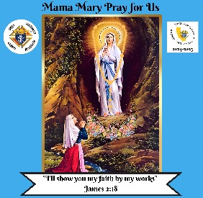

KNIGHTS OF COLUMBUS
CALIFORNIA STATE COUNCIL
Annual Campaign Supporting
People With
Intellectual Disabilities
Presented by:
Dr. Raymond Warriner
President
I Will Show My Faith Through My Works!
Mother Mary Pray For Us

Slide 2
PARTICIPATING COUNCILS
Total Raised Year to Date: $378,431.47
158 Councils Participating
Largest Recipients:
Special Olympics North and South:
General Contributions: $26,933.87
Feed the Athletes: $27,888.53
Plane Pull: $8,519.00
Clay Shoot: $14,391.06
Grand Total for Special Olympics: $77,732.46
Sacramento Diocese Camp ReCreation: $41,171.12
ARCs: $19,882.24

Slide 3
2024-2025 CHAPTER STATUS
Chapter Name | # Councils | Gross
 | In Chapter | Contributions
Northern California | 72 | $76,908.47
San Diego Diocese | 64 | $50,770.91
Arrowhead/Desert Valley | 62 | $46,281.32
San Jose | 24 | $32,623.42
Central | 41 | $31,032.26
Oakland | 47 | $29,035.15
Southern California | 64 | $22,116.50
Junipero Serra | 18 | $18,098.26

Slide 4
2024-2025 CHAPTER STATUS
Chapter Name | # Councils | Gross
 | In Chapter | Contributions
San Gabriel | 32 | $16,709.39
San Joaquin | 26 | $14,087.45
Orange County | 45 | $11,240.36
St. Francis | 26 | $10,899.94
Los Padres | 19 | $8,407.43
Mission High Desert | 11 | $5,790.90
Redwood | 15 | $4,429.71
Kern - Inyo | 15 | $0.00
Total | 583 | $378,431.47

Slide 5
2024-2025 TOP COUNCILS
Rank | Council No. | Council Name | Amount
1 | 4970 | Arden-Carmichael | $35,846.40
2 | 3726 | Los Banos | $27,600.00
3 | 5392 | San Gorgonio | $10,300.00
4 | 4112 | St. Victor | $9,202.00
5 | 2692 | George A. Coit | $9,120.00
6 | 6149 | Auburn | $8,207.00
7 | 4041 | Tracy | $7,491.45
8 | 8747 | St. Elizabeth | $6,854.58
9 | 9202 | St. Josephs | $6,476.98
10 | 958 | Watsonville | $6,324.78

Slide 6
2024-2025 TOP COUNCILS
Rank | Council No. | Council Name | Amount
11 | 1242 | Monrovia | $5,624.00
12 | 3052 | Mary Help of Christians | $5,367.00
13 | 3472 | St. Cabrini | $4,818.50
14 | 9667 | Holy Spirit | $4,675.00
15 | 7390 | Chula Vista | $4,580.00
16 | 6332 | James Francis Cardinal McIntyre | $4,507.26
17 | 6038 | St. Bonaventure | $4,500.00
18 | 6066 | Fair Oaks | $4,476.00
19 | 3589 | Joseph P. Schultz | $4,352.50
20 | 1990 | Los Crusados | $4,250.00

Slide 7
2024-2025 TOP COUNCILS
Rank | Council No. | Council Name | Amount
21 | 3474 | Bishop O'Dowd | $4,162.17
22 | 3436 | Our Lady of Fatima | $4,010.63
23 | 9022 | St. Elizabeth Seton | $4,000.00
I Will Show My Faith Through My Works!
Mother Mary Pray For Us

Slide 8
100% Districts
District No. | District Deputy
71 | Thomas J. Mello
116 | Sandro Ramirez
125 | Salvador C. Negrete
146 | Conrad Trinidad
165 | Chuck E. Wright
168 | Jaime J. Delgado
179 | Armando L. Mena
I Will Show My Faith Through My Works!
Mother Mary Pray For Us

Slide 9
2024-2025 GRANT AWARD RECIPIENTS
T.H.E. Center, Inc. – Sensory Spaces to Support Equine Wellness Programs – $10,000
Sponsored by Father James A. Hyland CSSP Council 10991, Murphy K. Arinze, Grand Knight
Mother Lode Rehabilitation, Inc. – Grow MORE Gardening Program – $5,117.75
Sponsored by Holy Trinity Council 12394, Randall S. Bickel, Grand Knight
We Can Fish, Inc. – Fish Big Bear Fishing Event for Special Needs Children – $5,560
Sponsored by Our Lady of Soledad Council 3847, Juan M. De Lara, Grand Knight

Slide 10
2024-2025 GRANT AWARD RECIPIENTS
ARC Los Angeles and Orange Counties – Arts Program Upgrades & Enhancements – $10,000
Sponsored by Saint Linus Council 10623, Salvador Ramirez, Grand Knight
Working Wonders – Culinary Program Enhancements – $1,600
Sponsored by Saint Anne Council 13899, Joseph R. Riggs, Grand Knight
Gigi's Playhouse – Down Syndrome Literacy Tutoring – $7722.25
Sponsored by Simi Valley Council 5803, Richard C. Ostrich, Grand Knight

Slide 11
2024-2025 GRANT AWARD RECIPIENTS
CONGRATULATIONS!
Thank you all the councils that participated!

Slide 12
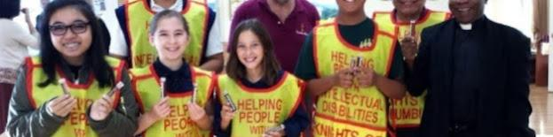
KNIGHTS OF COLUMBUS
CALIFORNIA STATE COUNCIL
The 2024-2025 Annual Campaign Supporting People With
Intellectual Disabilities is not over yet!
Contributions will continue to be accepted through June 30, 2025
I Will Show My Faith Through My Works!
Mother Mary Pray For Us

Slide 13
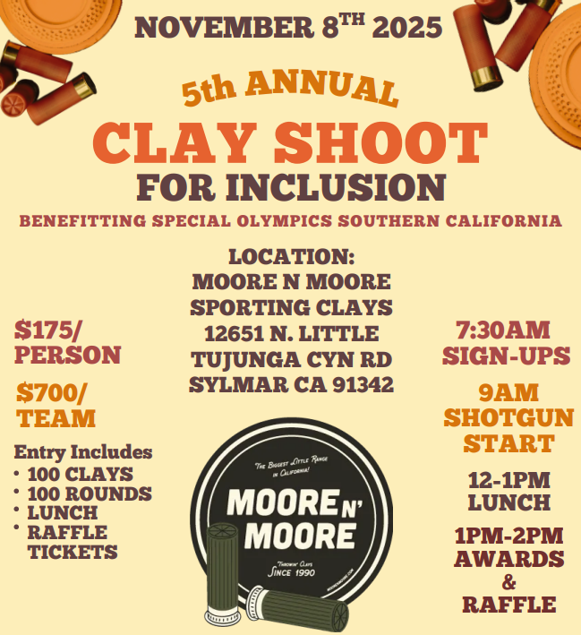
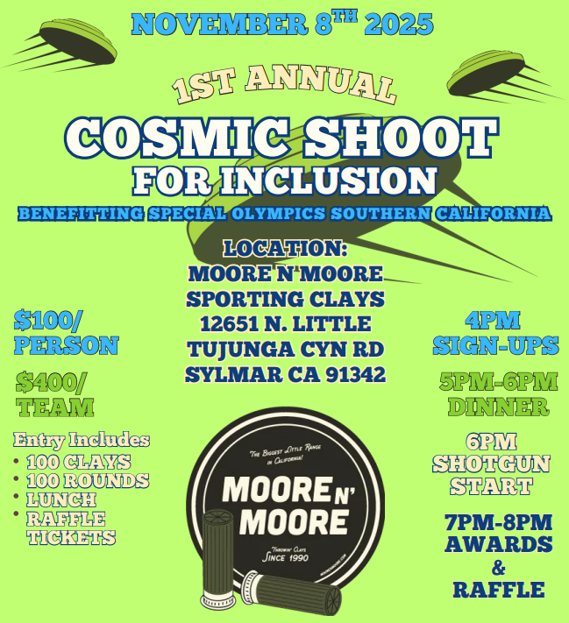
UPCOMING EVENTS

Slide 14

UPCOMING EVENTS

Slide 15
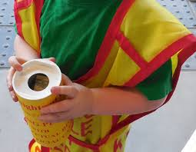
UPCOMING EVENTS
2025-2026 Annual Fund Drive
October 17, 18 & 19, 2025

Slide 16
IN THE FUTURE
7.5%
Indirect

Slide 17
IN THE FUTURE
7.5%
Indirect
X

Slide 18

KNIGHTS OF COLUMBUS
CALIFORNIA STATE COUNCIL
id.drive@californiaknights.org
www.columbian-foundation.org
I Will Show My Faith Through My Works!
Mother Mary Pray For Us

